Slide 1


eDOCS DM Implementation Topics Technical Overview
Steve Simpson
Escalation Team (SWAT)
Senior Principal Product Specialist
Open Text Corporation U.S.A.
Rev 2.0 01102010

Slide 2
Agenda
1
Upgrade Considerations
2
DM Component Configuration
3
The Database
4
The Network
5
Architecture Scenarios

Slide 3

Upgrade Considerations
Microsoft .NET Framework 3.0
    Prerequisite for all DM 5.3 products
      (In DM 5.2.1 it was .NET 2.0)
Library Generator
  New database schema changes
    New SP_GETNEXT key
    Multiple files types
Upgrading from DM 5.1.0.5 and 5.2.1
  Fully supported
    No support for upgrading from DM 5.1
No more CD’s to hunt down
  Full ISO image will be available to download from the Open Text Knowledge Center

Slide 4

Upgrade Considerations
New version of the DM Viewer
  New viewer version 8.3.5 of Oracle file formats
    Full support for Office 2010
New version of eDOCS Search Server
  eDOCS Search Server has been upgraded to version 6.5
    The implementation with the DM Server has been enhanced for more efficient management of large search results
    No.... You DON’T need to create new indexes
      But, if you don’t you may have search term highlighting issues because of the new viewer filters.
Hybrid Searching is enabled by default
  Your custom columns will still need to be included
8.3.5

Slide 5
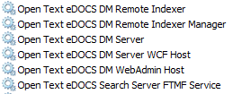
Upgrade Considerations
The DM Services have been rebranded
  And we added a couple of new ones

Slide 6
Upgrade Considerations
The DM Services have been rebranded
        Open Text eDOCS DM Remote Indexer
          Shared indexes handled by this service
        Open Text eDOCS DM Remote Indexer Manager
          This is the FTSVCADM.EXE
        Open Text eDOCS DM Server
          DOCSFusion.exe service
        Open Text eDOCS DM Server WCF Host
          Connectivity with NetTCP and wsHTTP
        Open Text eDOCS DM WebAdmin Host
          Used to enable DM Admin in the WebTop. The service is set to manual and the Webtop starts and stops as required
        Open Text eDOCS Search Server FTMF Service
          Manages which viewer is invoked

Slide 7
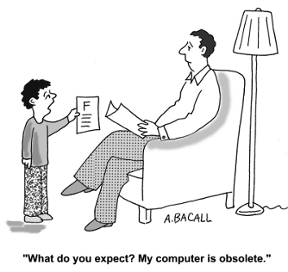
Upgrade Considerations
Supported Operating System versions
      DM Server
        Windows 2008 R2 – 64 bit
        Windows 2003 R2 – 32 bit
      DM Web Server
        Windows 2008 R2 – 64 bit
        Windows 2003 R2 – 32 bit
      DM Extensions
        Windows 7 – 64 bit
          (We have a separate 64 bit installer)
        Windows 7 – 32 bit
        Windows Vista – 32 bit
        Windows XP Professional – 32 bit

Slide 8
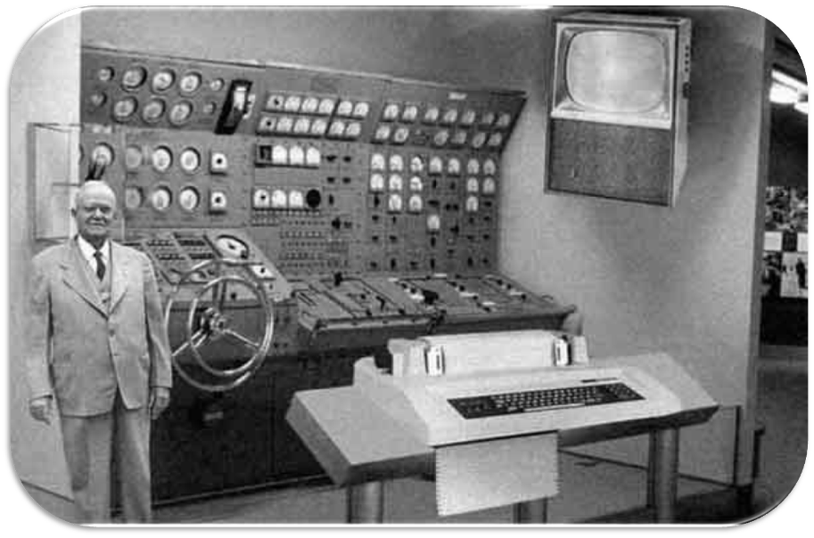
Upgrade Considerations

Slide 9
Agenda
1
Upgrade Considerations
2
DM Component Configuration

Slide 10
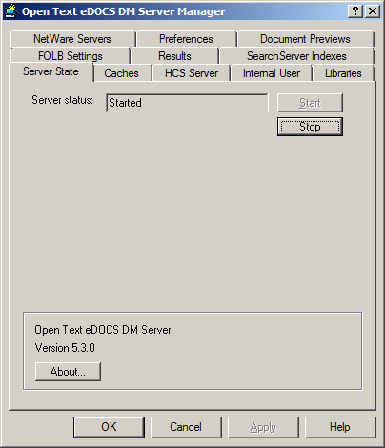
DM Component Configuration
The DM Server
      Brokers transactions between end user workstations and the SQL server, the document server, and the indexer
      Retains a cache of metadata for quicker retrieval
      Throughput to the SQL Server & Document Server
        Highly recommended that the DM Server be on the same switch as the SQL Server and Document Server
        1GB backbone on the same switch as the SQL Server and Document Server
      Use TCP/IP protocol between DM Servers and SQL Servers

Slide 11
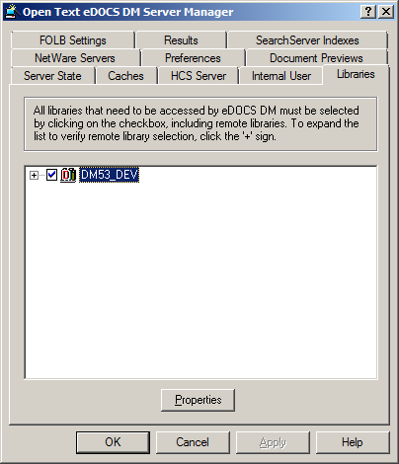
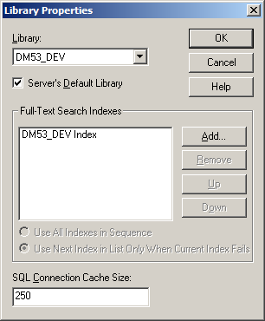
DM Component Configuration
The DM Server
      SQL Connection cache size
        The default value is 5
      With DM 5.3 the max is 250 per library, recommended value:
        start on “250”, minimum “150”
      For Remote Libraries keep the default of “5”

Slide 12
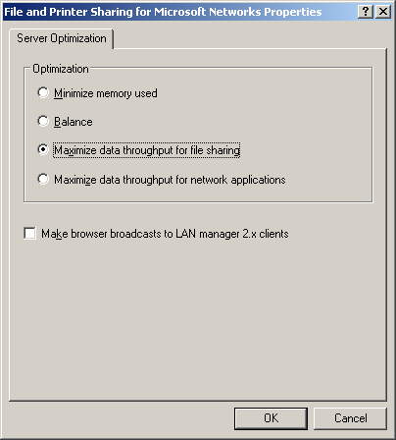
DM Component Configuration
The DM Server
      Windows 2003
        For Document Servers the property of each NIC must be:
          “Maximize data throughput for file sharing”
        For the DM or SQL Server the property of each NIC must be:
          “Maximize data throughput for network applications”
      On Windows 2008 this setting is in the registry (however it is no longer used)

Slide 13
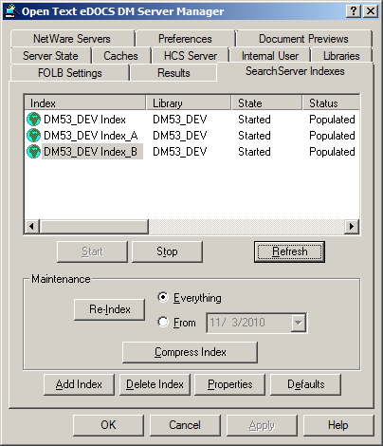
DM Component Configuration
The DM Index Server
      If possible allocate a second indexer to provide Fail Over capabilities
      Do not index over the WAN
      Enable Hybrid Searching (default for 5.3)
      When indexing, files are stored in the C:\Windows\Temp
        In some cases the files may not be deleted after indexing
        Make sure the drive that holds the temp directory has adequate space
        Do not Virus Scan the temp directory

Slide 14
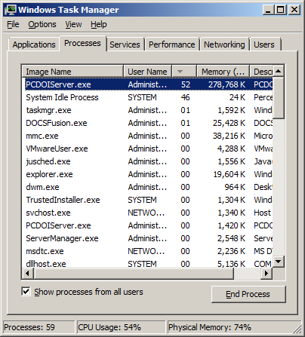
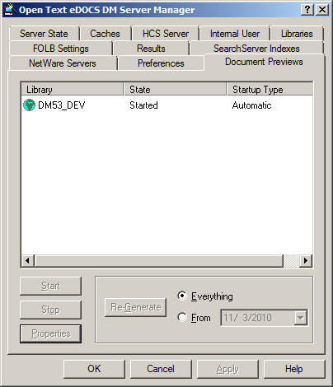
DM Component Configuration
The DM Preview (Generator) Server
      Creates a Preview of documents
        These files are stored on the DM document server(s)
        The Path is found in the versions table
      Should be located on a dedicated machine
        Can be a workstation class machine
      Uses large amounts of resources
      Any errors are added to the event logs

Slide 15
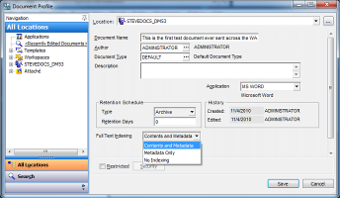

DM Component Configuration
DM Extensions
      New Indexing option
        Contents and Metadata
          Indexes both the content of the document and the profile fields
        Metadata Only
          Indexes only the Profile fields
        No Indexing
          Does not index the document at all

Slide 16
Agenda
1
Upgrade Considerations
2
DM Component Configuration
3
The Database

Slide 17


The Database
Supported DB versions
  SQL Server
    Oracle 10g Release 2
    Oracle 11g Release 2
  SQL Server
    MS SQL 2005 (mode 90)
    MS SQL 2008, 2008 R2 (mode 100)
      32 or 64 bit
    MS SQL 2000 is no longer supported

Slide 18
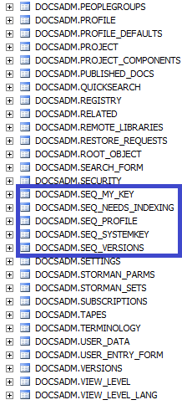
The Database
Database changes
    New SP_GETNEXT key for MSSQL
    DOCS_UNIQUE_KEYS table no longer used
    Old incorrect code or triggers will no longer work
    Uses sequences
    Customizable
    2.147 Billion limit on SYSTEM_IDs per Library

Slide 19
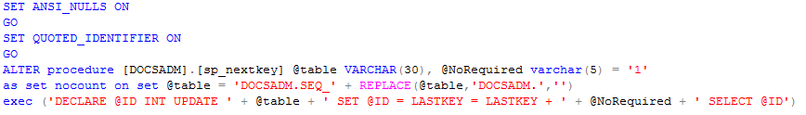
The Database
SP_GETNEXT key
    Correct way to call the SP
    declare @system_id int
    update DOCSADM.SEQ_SYSTEMKEY set @SYSTEM_ID = LASTKEY=LASTKEY+1
      Or
      exec DOCSADM.sp_nextkey SYSTEMKEY, 5
      The number, in this case 5, is an optional value
      Returns last value

Slide 20
The Database
SP_GETNEXT key
    Add your own
    -- create new sequence table
    CREATE TABLE DOCSADM.SEQ_MY_KEY
    (
    LASTKEY int NULL
    )
    GO
    -- grant access to the new sequence
    GRANT ALL ON DOCSADM.SEQ_MY_KEY TO DOCS_USERS
    GO
    -- populate the initial value of the sequence
    INSERT INTO DOCSADM.SEQ_MY_KEY
    (LASTKEY) VALUES (0)
    GO

Slide 21
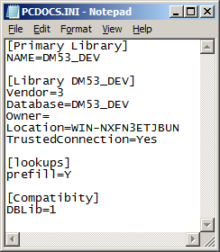
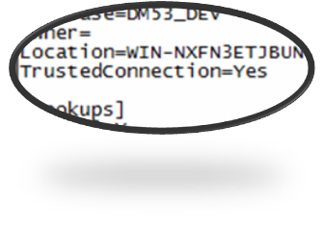

The Database
No support of the old SQL 2000 client
    You should now install the SQL 2008/05 native client on all DM Servers
      Trusted Connections
        No more worrying about which user is specified
        Two tier tools (like Library Maintenance) work with the new setting
        Uses the logged in user to access SQL (Audit capabilities in SQL)

Slide 22
Agenda
1
Upgrade Considerations
2
DM Component Configuration
3
The Database
4
The Network

Slide 23
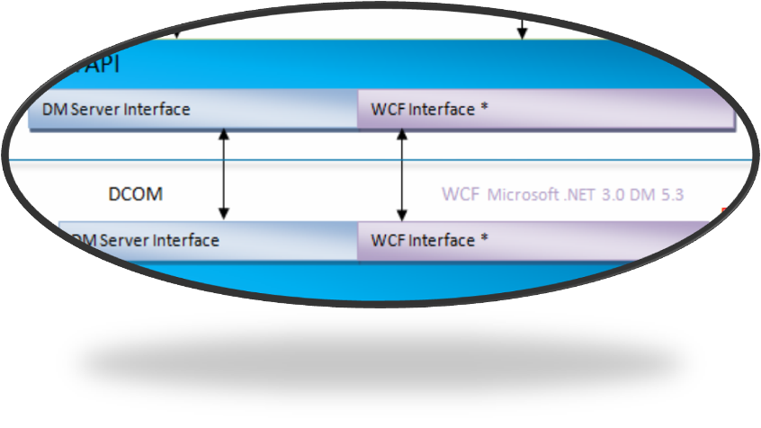



Web Client
Lotus Notes
Windows Explorer
Outlook
Interceptor
Office Apps
HTTP
or SSL
COM
COM
COM & MAPI
Win msgs
COM
VSTO
Microsoft IIS
DM
Extensions
Core
DM Ext.
API
Plugging
Application Integration
FSPlugin
DM Web
Server
RM
Workflow
RM Web
DM Web Admin
Attaché
SAPI
DV
COM
COM
COM
DM API
DM 5.3 CLIENT COMPONENTS
DM Server Interface
WCF Interface *
DCOM
WCF Microsoft .NET 3.0 DM 5.3
DM 5.3 SERVER COMPONENTS
DM API
Workflow Server
Search Server
DM Server Interface
WCF Interface *
COM
Searching
RM Server
Dynamic Views
Preview
Indexer
Profile
DB
Events
Security
Doc. Server
Search Server ODBC
Search Server ODBC
ODBC, Native
Proprietary protocol
Dependant on Doc. store type
THIRD TIER COMPONENTS
SQL DB
Full text Index
SQL DB
MSSQL, Oracle
Document Server
Designer
Import utilities
Custom events sent to HTTP Server
Security Services
NTFS, DSA
SMB

Slide 24
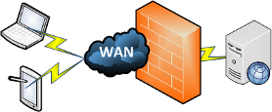
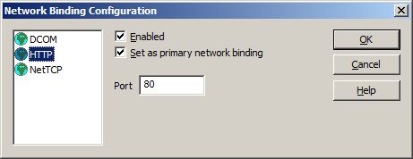
The Network (wsHTTP vs. NetTCP vs. DCOM)
wsHTTP
  Packet from the client/server has MAX encrypted
    Message encryption (256bit)
    Header encryption (256bit)
  Very easy to configure
  Operates on a single configured port (default 80)
  Can easily go through a firewall
  Can be accelerated with devices like a Riverbed Steelhead® or Cisco WAE

Slide 25

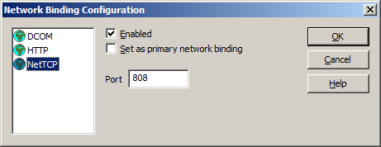
The Network (wsHTTP vs. NetTCP vs. DCOM)
NetTCP
  Packet from the client/server is encrypted
    Message encryption (128bit)
  Roughly 50% faster than wsHTTP
  Very easy to configure
  Operates on a single configured port (default 808)
  Can easily go through a firewall
  Can be accelerated with devices like a Riverbed Steelhead® or Cisco WAE

Slide 26

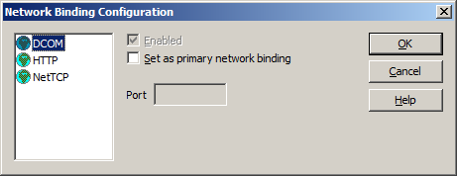
The Network (wsHTTP vs. NetTCP vs. DCOM)
DCOM
  The fastest of the connection methods
  Roughly 20% faster than NetTCP
  Still the best in most case
  Can not easily be encrypted
  Hard to configure
  Needs < 20 millisecond ping time
  Can NOT easily go through a firewall
  Can NOT be easily accelerated with devices like a Riverbed Steelhead® or Cisco WAE

Slide 27
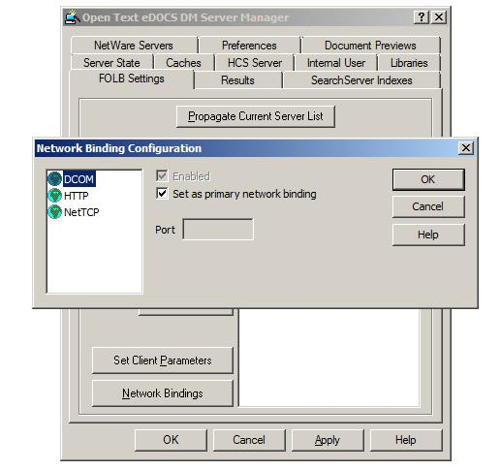
The Network (wsHTTP vs. NetTCP vs. DCOM)

Slide 28
The Network
Bandwidth vs. Latency
  What is Bandwidth
    The average rate of successful data transfer through a communications path
    Usually measured in KB/s or Mb/s
    A 100 megabit connection has a max of 12.5 Meg/sec transfer rate
      100mb file will take roughly 8.39 seconds to copy
    A 1000 megabit (1GB) connection has a max of 125Meg/sec
      100mb file will take roughly 0.84 seconds to copy

Slide 29
The Network
Bandwidth vs. Latency
  What is Latency
    The time it takes for data to be passed from the source to a server and back again
    Usually measured in milliseconds
    A 42 ms Latency means that it took 42 milliseconds to travel from the source to the destination then back to the source
Reduce latency?
  How is that possible?
    Unless you can figure out how to overcome the speed of light there is nothing you can do to reduce the real latency between sites

Slide 30
Agenda
1
Upgrade Considerations
2
DM Component Configuration
3
The Database
4
The Network
5
Architecture Scenarios

Slide 31
Architecture Scenarios
DM System Topology
  Design of the eDOCS DM solution will need to take into account the layout of your organization across departments, offices, regions, etc
    Note: If your organization has offices in different physical locations, and you want to have eDOCS DM libraries in each office that are remote to each other, recommendations regarding WAN connectivity are of particular importance
  Please see the Champion Toolkit document "Best Practices - eDOCS DM 5.2.1 Implementation Guide“ for more information
  At a high level, there are three main topologies available
    Distributed Architecture
    Centralized Architecture
    Hybrid Architecture

Slide 32
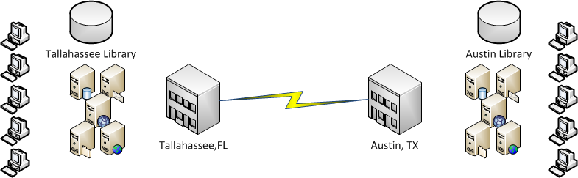
Architecture Scenarios
DM System Topology
  Distributed Architecture
    In a geographically distributed eDOCS DM architecture, each regional site has its own self contained DM system. With the ability of the DM servers to connect to remote libraries, users have the ability to search for documents across the entire enterprise

Slide 33
Architecture Scenarios
DM System Topology
  Distributed Architecture
    The recommended architecture
    Buffers the user from WAN outages
    Very fast
    High Bandwidth
    Low Latency

Slide 34
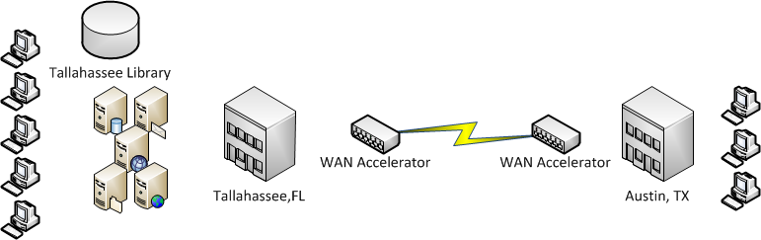
Architecture Scenarios
DM System Topology
  Centralized Architecture
    In a centralized architecture design, all of the DM Server application components are located in a central location. The regional user population will connect to the DM servers over the WAN.

Slide 35
Architecture Scenarios
DM System Topology
  Centralized Architecture
    Best for large deployments/number of users
    Minimizes administration overhead cost
    Invest your savings in the infrastructure
    No buffer from WAN outages (Plan for network redundancy)
    WAN Accelerators provide additional performance gains (if used with NetTCP)

Slide 36
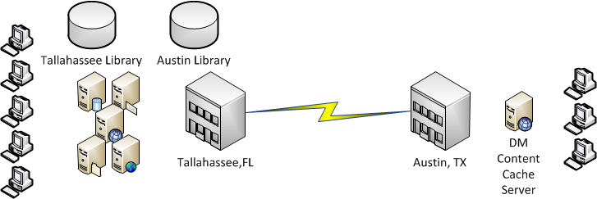
Architecture Scenarios
DM System Topology
  Hybrid Architecture
    In a hybrid architecture design, the regional locations have local DM servers that connect to a central database server and document store. The remote locations may also have a local document store and DM Content Caching servers.

Slide 37
Architecture Scenarios
DM System Topology
  Hybrid Architecture
    Most flexible scenario to meet all customer environments
    Includes the respective limitations and benefits of the previous models
    Your network infrastructure drives the library design decisions
    We recommend the Content Cache “Lazy Write” feature for high latency environments
      For remote sites with a small number of users

Slide 38
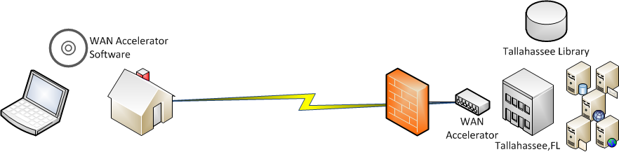
Architecture Scenarios
DM System Topology
  The Home User
  Demo

Slide 39

Thank you all for attending

Slide 40
Thank You

